Slide 1
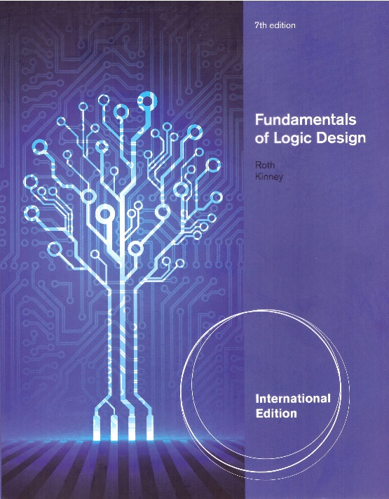
Unit 2 Boolean Algebra
This chapter in the book includes:
Objectives
Study Guide
2.1 Introduction
2.2 Basic Operation
2.3 Boolean Expression and Truth Table
2.4 Basic Theorem
2.5 Commutative, Associative, Distributive & DeMorgan’s Laws
2.6 Simplification Theorem
2.7 Multiplying Out and Factoring
2.8 Complementing Boolean Expressions

Slide 2
Objectives
Topics introduced in this chapter:
Understand the basic operations and laws of Boolean algebra
Relate these operations & laws to AND, OR, NOT gates & switches
Prove these laws using a truth table
Manipulation of algebraic expression using
Multiplying out
Factoring
Simplifying
Finding the complement of an expression

Slide 3
2.1 Introduction
Boolean algebra : Basic mathematics for logic design
Restrict to switching circuits
Two state values: 0, 1
Switching algebra
Boolean Variable
X, Y, … can only have two state values (0, 1)
Representing True(1), False(0)

Slide 4
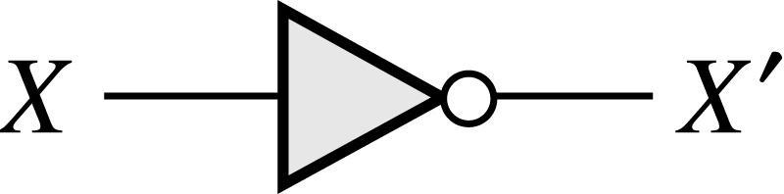
2.2 Basic Operations
NOT (Inverter)
Gate Symbol

Slide 5
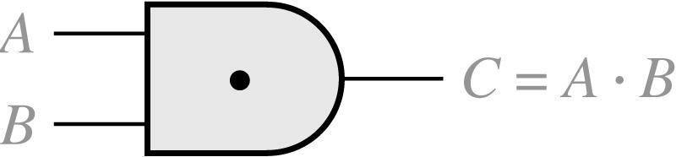
2.2 Basic Operations
AND
Truth Table
A B | C = A · B
0 0 0 1 1 0 1 1 | 0 0 0 1
Gate Symbol

Slide 6
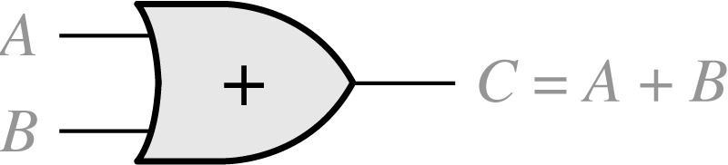
2.2 Basic Operations
OR
Truth Table
A B | C = A + B
0 0 0 1 1 0 1 1 | 0 1 1 1
Gate Symbol

Slide 7
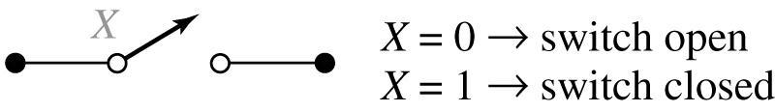
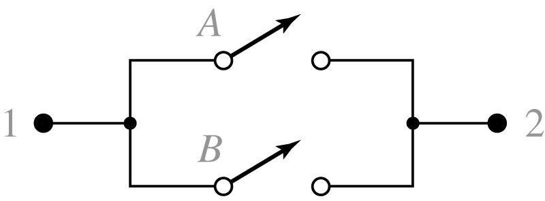
2.2 Basic Operations
Apply to Switch
AND
OR

Slide 8
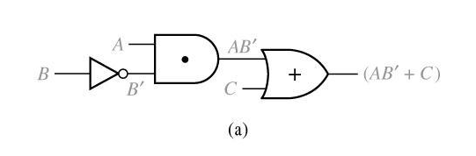
2.3 Boolean Expressions and Truth Tables
Logic Expression
Circuit of logic gates

Slide 9
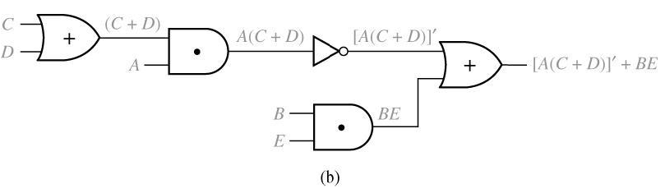
2.3 Boolean Expressions and Truth Tables
Logic Expression
Circuit of logic gates
Logic Evaluation : A=B=C=1, D=E=0
Literal : a variable or its complement in a logic expression
10 literals

Slide 10
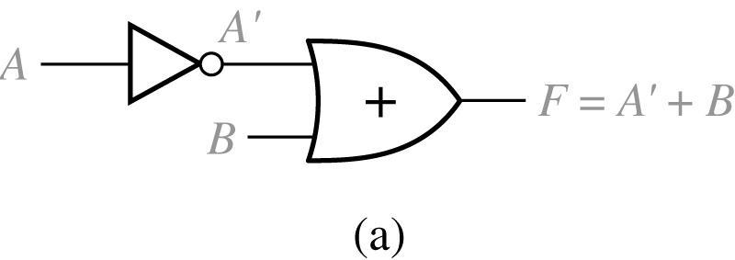
2-Input Circuit and Truth Table
2.3 Boolean Expressions and Truth Tables
A B |  | A’ | F = A’ + B
0 0 0 1 1 0 1 1 |  | 1 1 0 0 | 1 1 0 1

Slide 11
2.3 Boolean Expressions and Truth Tables
Proof using Truth Table
n variable needs rows
n times
TABLE 2.1
A B C |  | B’ | AB’ | AB’ + C |  | A + C | B’ + C | (A + C) (B’ + C)
0 0 0 0 0 1 0 1 0 0 1 1 1 0 0 1 0 1 1 1 0 1 1 1 |  | 1 1 0 0 1 1 0 0 | 0 0 0 0 1 1 0 0 | 0 1 0 1 1 1 0 1 |  | 0 1 0 1 1 1 1 1 | 1 1 0 1 1 1 0 1 | 0 1 0 1 1 1 0 1

Slide 12
2.4 Basic Theorems
Operations with 0, 1
Idempotent Laws
Involution Laws
Complementary Laws
Proof
Example

Slide 13
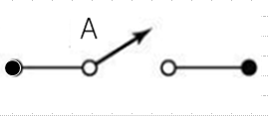
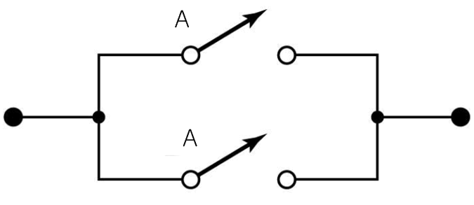

2.4 Basic Theorems
Circuit Examples
A
A
=
=
=

Slide 14
2.4 Basic Theorems
Circuit Examples
=
(A+1=1)
=
A’
(A+A’=1)
=
(A A’=0)

